Slide 1
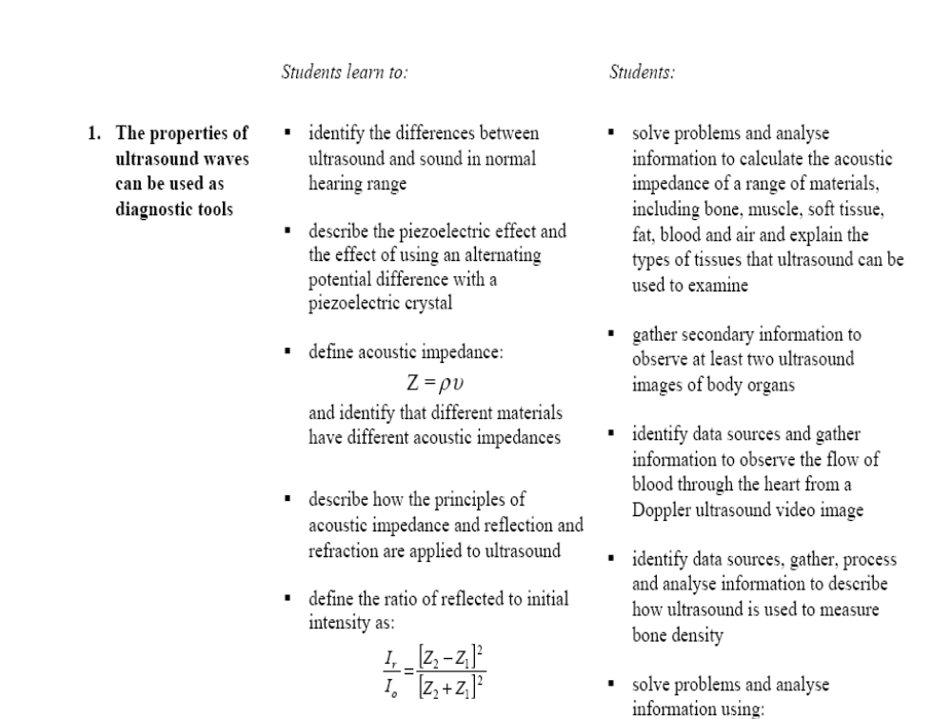

Slide 2
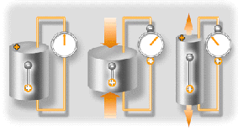
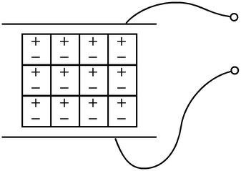
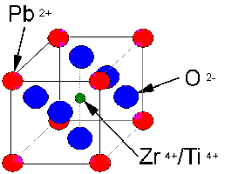
What is the Piezoelectric effect?
The Piezoelectric effect is an effect in which energy is converted between mechanical and electrical forms.
It was discovered in the 1880's by the Curie brothers. Specifically, when a pressure (piezo means pressure in Greek) is applied to a polarized crystal, the resulting mechanical deformation results in an electrical charge.
The piezoelectric effect is when a special crystal expands and contracts when an alternating voltage is applied across it, producing sound waves.
This is due to the dipoles in the crystal which rotates due to the AC.
Electrical energy is converted into the ultrasound pressure wave. A commonly used crystal is lead zirconate titanate (PZT).
Each crystal transducer has its own natural resonant frequency which depends on the crystal thickness.
The electrical voltage driving the transducer should match the natural vibrational frequency of the transducer to maximise the conversion of the electrical energy into ultrasound energy.
The frequency the crystal produces is dependant only on the thickness of the crystal, with the wavelength produced usually being twice the length of the crystal

Slide 3
Piezoelectric Effect in depth
When a piezoelectric crystal is subjected to stress it produces an alternating voltage and when an alternating voltage is applied the crystal changes shape.
This is also known as the piezoelectric effect.
Thus a piezoelectric crystal is used to produce ultrasound by applying an alternating voltage to the crystal - the frequency of the ultrasound is determined by the frequency of the AC voltage used.
The crystal can also be used to receive reflected ultrasound.
The reflected ultrasound causes the piezoelectric crystal to change shape (it is put under stress) and this changing shape causes an AC voltage to be produced.
Piezoelectric crystals can be made from material such as quartz (SiO2) or barium titanate (BaTiO3) or a polymer, poly vinylidene difluoride (PDVF).
These crystals have no net charge, but when they change shape they become polarised, i.e. they have a definite positive and negative end.
This polarisation changes when the shape changes the opposite way – when it goes from pushing in (thinner) to pulling out (thicker). This allows the voltage to change as well.
Transducers contain piezoelectric crystals to produce ultrasound and detect ultrasound.

Slide 5
Acoustic Impedance
it is a measure of how readily sound will pass through a material.
When an ultrasound wave meets a tissue it can either be refracted and/or reflected.
These properties are the same for all waves when they move from medium of one density to another medium of a different density.
The strength of the ultrasound wave reflected from a boundary of different tissue types depends on the difference in acoustic impedance between the tissue types.
The greater the difference in acoustic impedance the greater the amount of ultrasound reflected.
Bone/tissue and air/tissue interfaces are very reflective, they prevent the imaging of weaker echoes from deeper, soft tissue interfaces.
It is the reflected ultrasound waves returning to the transducer that produce an image.
Acoustic impedance (Z) of a tissue is related to its density (p) and the speed of sound in that tissue (v).
In other words,
Z = pv.
It is measured by kg m⁻² s⁻¹

Slide 6
Open your text book on page 343 to examine the value of some body materials

Slide 7
Problem solving
An ultrasound wave of 2.0 MHz traveling through brain. Calculate:
The wavelength of the ultrasound.
The acoustic impedance of the brain.
Use the wave equation v = f λ
Use the acoustic impedance equation
Z = pv

Slide 9
Reflection of Ultrasound
When ultrasound waves are transmitted through the body, they reflect at boundaries between different types of tissue, more specifically, tissues of different acoustic impedances.
The waves are also absorbed and the time lapse and intensity difference in the returning signal can indicate the nature and position of the organs and tissue.
The absorbed rays undergo some refraction according to Snell’s Law as they move from mediums of different densities.
The greater the difference in acoustic impedance, the greater the proportion of the incident pulse that is reflected.
This property makes ultrasounds useful in detecting tissue which have a large difference in acoustic impedance such as kidney or gall stones in kidney or gallbladder tissue.

Slide 10
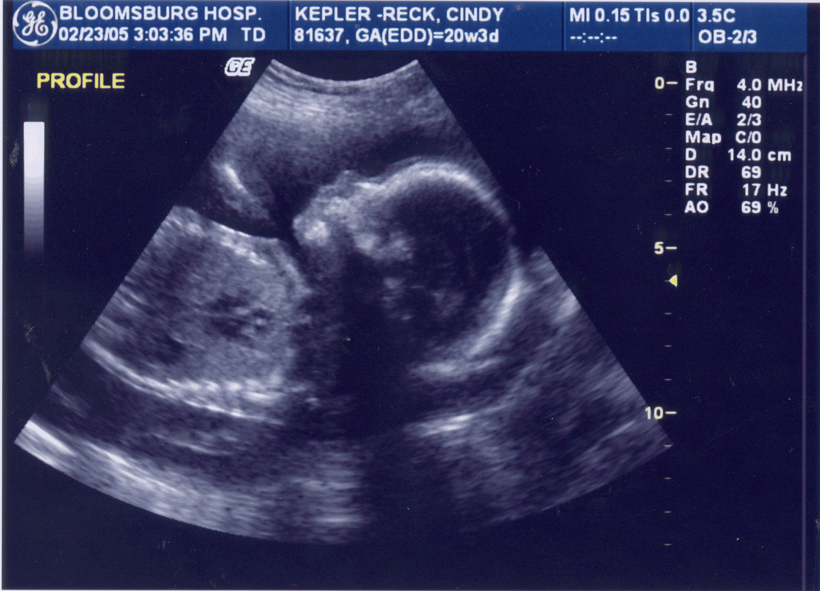
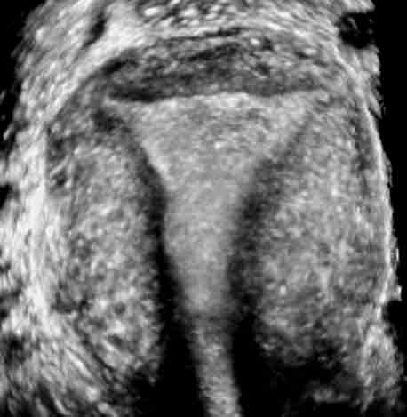
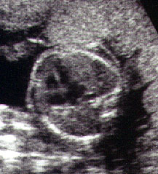
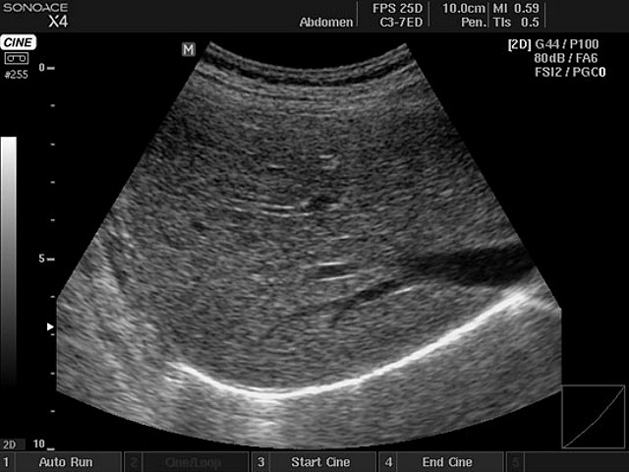
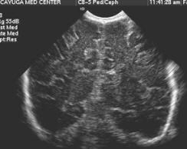

Slide 11
Different types of Ultrasound scan
A- scan
B- scan
Doppler scan
3D- scan

Slide 13
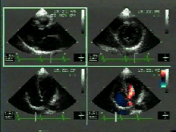
Echocardiogram
Another use of ultrasound is to picture the heart's size, shape, and movement.
Echocardiography is the process of mapping the heart through echoes.
The pulses are sent into the chest and the high-frequency sound waves bounce off of the heart's walls and valves.
The returning echoes are electronically plotted to produce a picture of the heart called an echocardiogram.
The procedure is safe and relatively comfortable for the patient.
However, sometimes an echocardiogram doesn't provide enough information and an invasive procedure may be necessary.

Slide 14
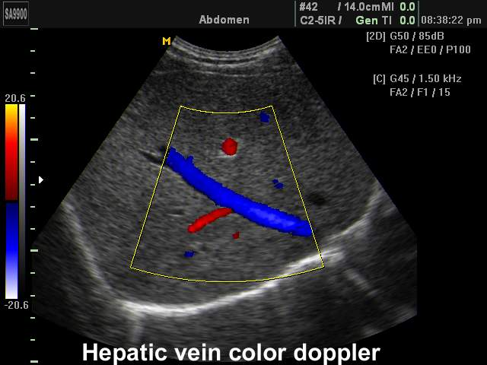
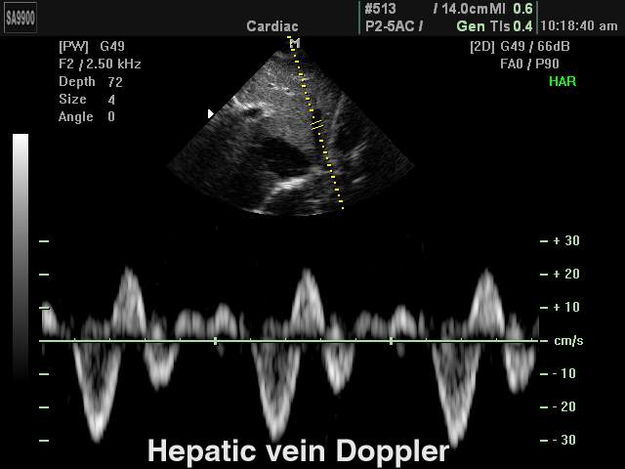
More graphs involving Echocardiogram

Slide 15
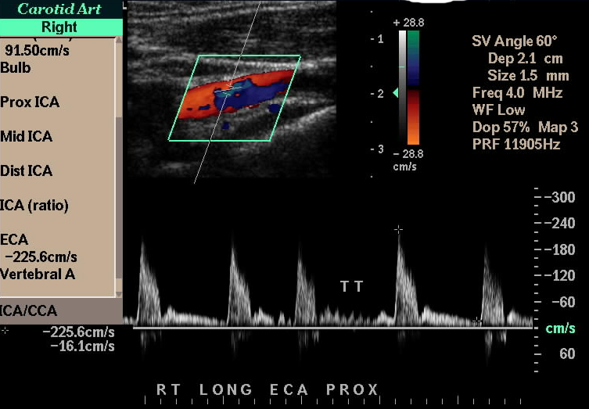
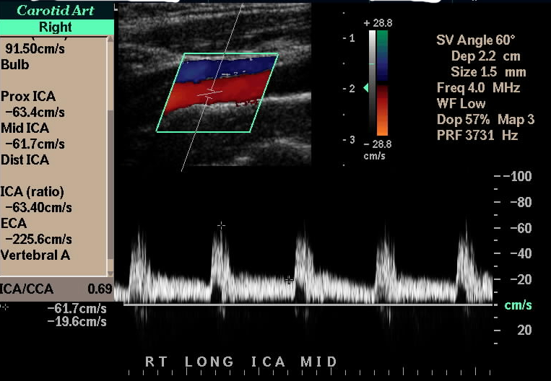
More graphs involving Echocardiogram
cardiac Doppler
Click here
http://www.fi.edu/biosci/monitor/echo.html

Slide 16
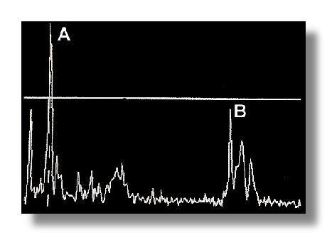
A- Scan
An A-mode picture is now obsolete in obstetric scans.
Wave spikes are represented when a single beam passes through objects of different consistency and hardness.
The distance between these spikes
( for example A and B ) can be measured accurately when on-screen calipers are not available in the old days.
At that time when ultrasound scanning was first invented the scans were single-pass scans and were known as 'static scans' as compared to the multi-pass real-time scans we have now.

Slide 17
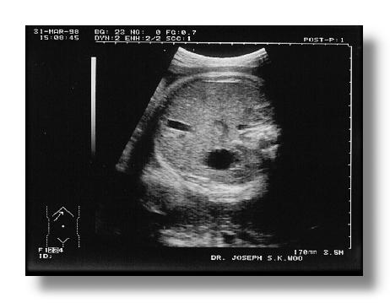
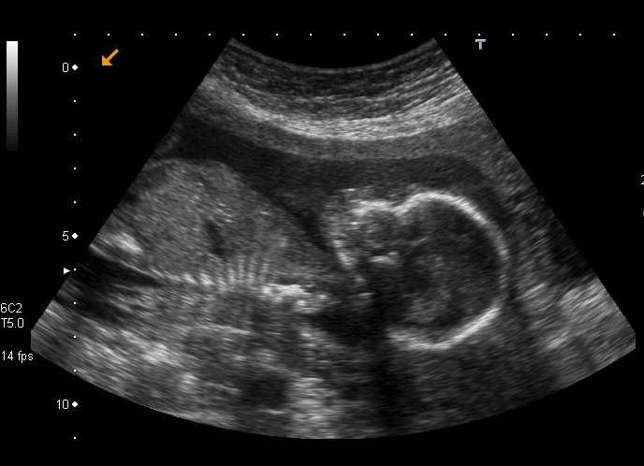
B- Scan
This is a typical grey-scale (typically in 256 shades of grey levels) B-scan sonogram image of the fetal abdomen at the level where the circumference will be measured.
Notice that in an ultrasound image solid areas are depicted in 'white' and the fluid areas in 'black'.
In this typical cross-sectional slice of the abdomen the stomach and umbilical vein (left side of the image) are seen.
An ultrasound image is always a slice of the part of the fetus that one tries to see.
When similar images are seen on the screen during a scanning session, mothers often thought this is the face of the fetus (with the two eyes, nose and mouth) as they would tend to wrongly perceive the image as a picture taken with a camera in front of the fetus.

Slide 18
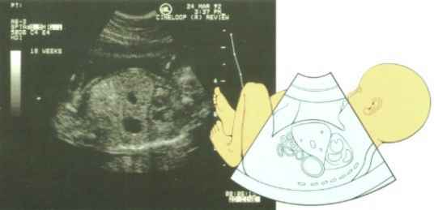
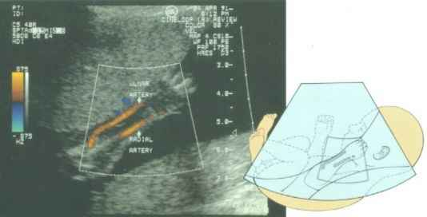
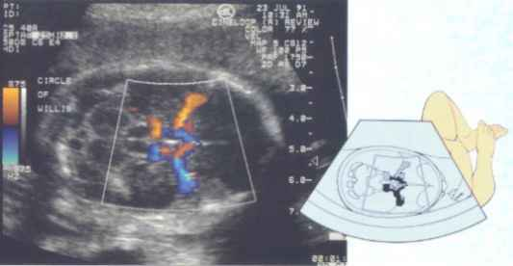
Samples of B-Scan images
 | 5 month fetus Fetal arm with major arteries clearly shown
5 month old fetus showing lungs, liver and bowel
Subtle differences in tissue texture allow the fetal lungs to be distinguished from the neighboring liver and bowel
Third trimester fetus
The fetal brain showing the intersection of the major blood vessels and surrounding structural anatomy.

Slide 19
Permanent polarization as in the case of the electrets is also observed in crystals. In these structures, each cell of the crystal has an electric dipole, and the cells are oriented such that the electric dipoles are aligned. Again, this results in excess surface charge which attracts free charges from the surrounding atmosphere making the crystal electrically neutral. If a sufficient force is applied to the piezoelectric crystal, a deformation will take place. This deformation disrupts the orientation of the electrical dipoles and creates a situation in which the charge is not completely canceled. This results in a temporary excess of surface charge, which subsequently is manifested as a voltage which is developed across the crystal.

